Slide 1
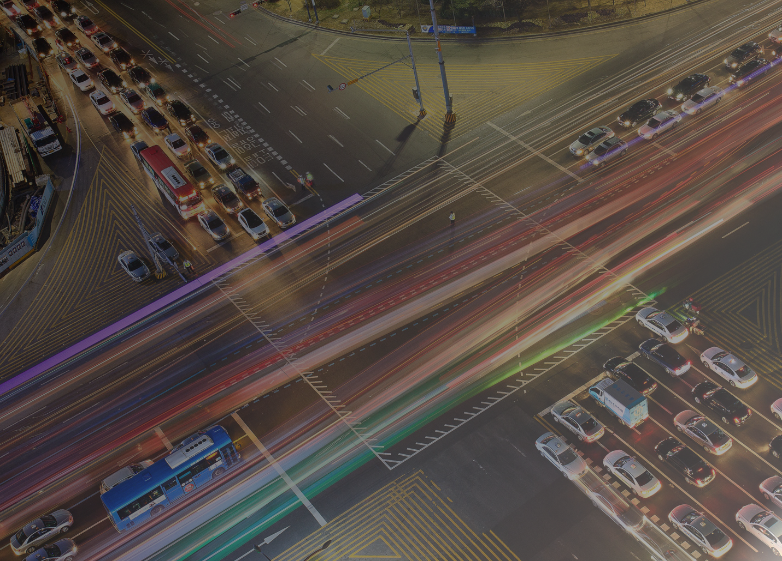
Smart Flow
Green lights, greener cities
Greenlights

Slide 2
Current Situation
Costs* 9 B€
Time lost*
150 h
Emissions* 800kt CO2
*Center for economic and business research

Slide 3



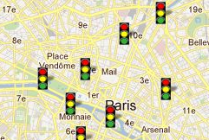



Value Proposition
Traffic Data
REAL TIME TRAFFIC LIGHT MANAGEMENT BY IA

Slide 4
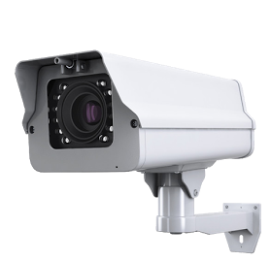

How it works
Street Camera Data
Data Traffic
Traffic Light Management

Slide 5



Market
Variable Cost
Inner city traffic jam
Fixed Cost
Municipalities
t
t
Notes:
Pas d efraids a installer données ddeja existantes Acces aux données

Slide 6

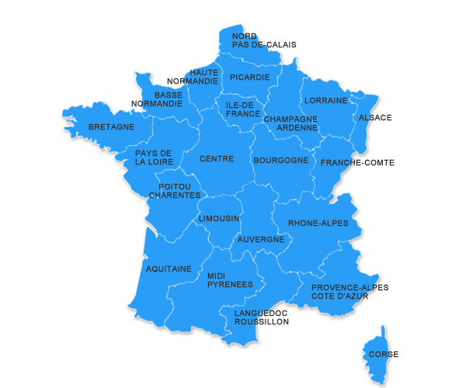
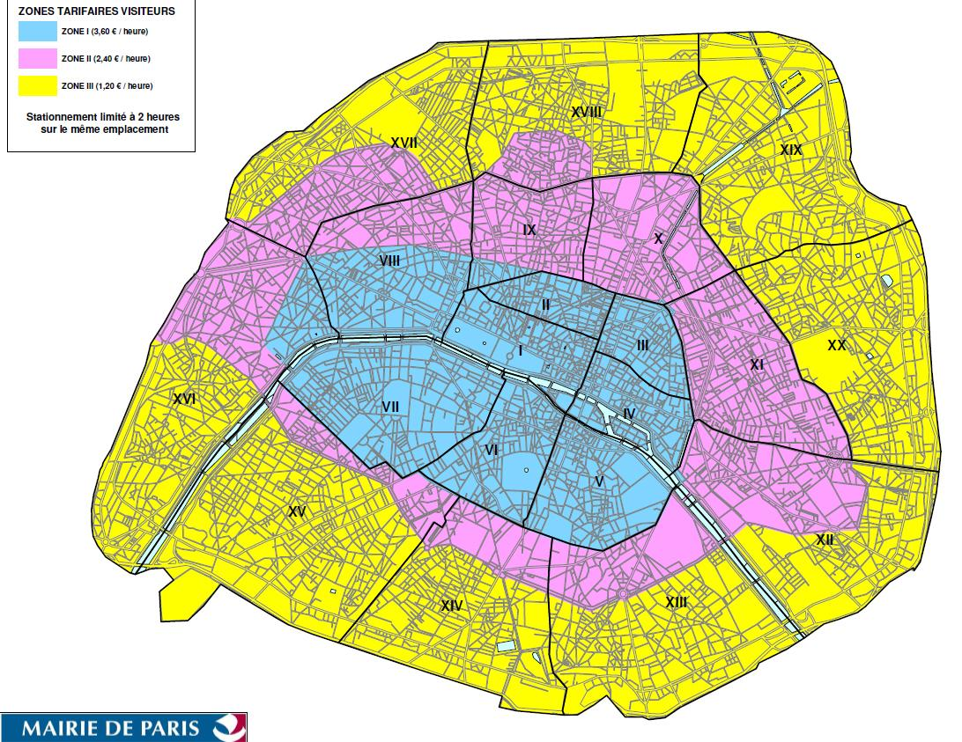
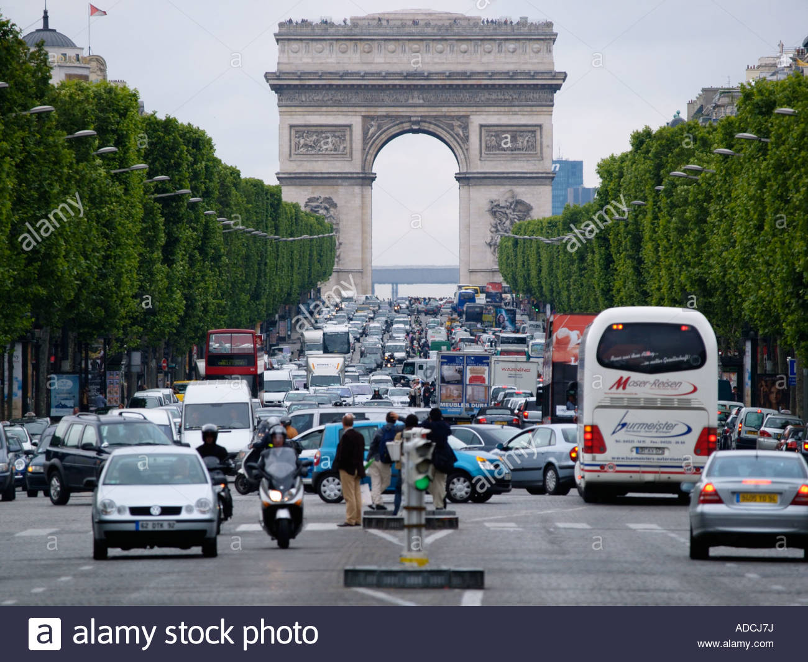
Business Plan
users
time

Slide 7
87M€
1% REDUCTION In PARIS

Slide 8

Client :
Road
Village
City
Simulation :
Optimal Traffic Light Cycle fitted to our city
Measure the
Data :
Traffic light
City map
Bob
Jean-Jacques
Hervé
Prototype

Slide 9
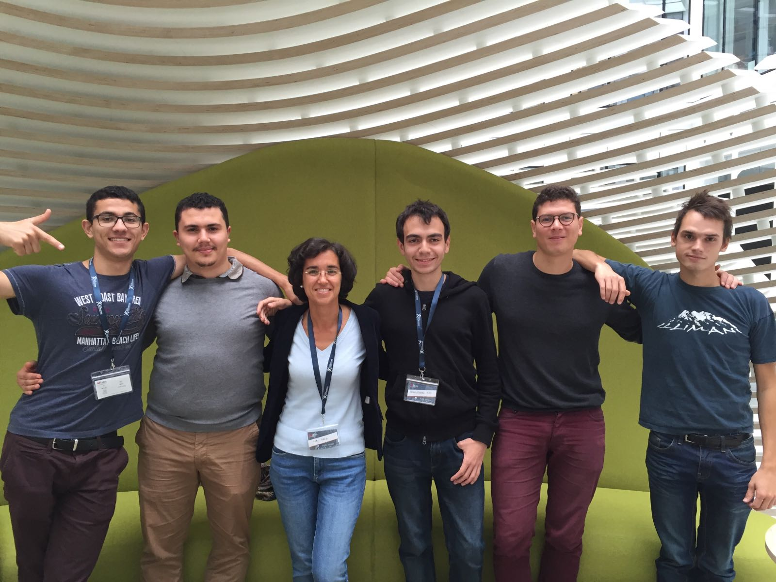
Thank you

Slide 10
Smart Flow
Green lights, greener cities
Greenlights

Slide 11
Alternatives
Pre established cycles
AI based Upgraded traffic lights
Self driven cars based AI system
Easy
More efficient
Extremely efficient
Not optimal
~ 30k$ per traffic light
Based on tomorrow’s technology

